Slide 1
Project Explainable Machine Learning (xAI-Proj-B) Image Classification Using ImageNet-1K Subset
Team : Synaptic Sparks
Members : Zeeshan Ahmed Muhammad Uzair Janjua
Notes:
In this project, we are working on a custom subset of ImageNet-1K containing 10 classes. Our goal is to train, evaluate, and compare deep-learning models like MobileNetV2 and ResNet50.

Slide 2
Motivation
Primary Goals:
Build a complete Machine Learning model using the ImageNet-1K Subset.
Learn how to train, test, and evaluate a custom image classifier from scratch.
Key Questions Explored:
Model Selection: Which architecture works better for small data (MobileNetV2 vs. ResNet50)?
The "Reality Check": Why does accuracy often drop significantly on real-world data?
Scope:
Hands-on experimentation with Transfer Learning.
Implementation of Grad-CAM for model debugging and explainability.
Notes:
Our motivation for this project was to learn the complete lifecycle of a Machine Learning model. We wanted to move beyond theory and build a classifier using the ImageNet subset.
Our main focus was answering two key questions: First, for a small dataset like ours, is a complex model like ResNet50 actually better, or is a lightweight model like MobileNetV2 superior?
Second, we wanted to perform a 'Reality Check'. We investigated why models often perform well in training but fail on real-world data.
To solve these problems, we used Transfer Learning to improve performance and Grad-CAM to debug exactly what the model was seeing.

Slide 3
Dataset Preparation
Dataset stored on Google Drive
Mounted in Google Colab
Unzipped into Colab runtime
Notes:
We placed our dataset ZIP on Google Drive. Colab mounts Drive, and we unzip the dataset into the local runtime for faster training speed. Colab runtime storage is temporary — but the ZIP remains safe in Drive.

Slide 4
Dataset Overview
Total classes: 10
Source: ImageNet-1K Subset
Classes: include coffee mug, mushroom, remote control, etc.
Files organized into:
/train/class_name/
/test/class_name/
Train set: 13000 images
Test set: 500 images
Notes:
We first explored the dataset structure to ensure it's compatible for training. Each class has its own folder for both train and test sets.
We checked the exact number of images in train and test folders. Having a reasonable test size ensures reliable performance evaluation and prevents overfitting to the train set.

Slide 5
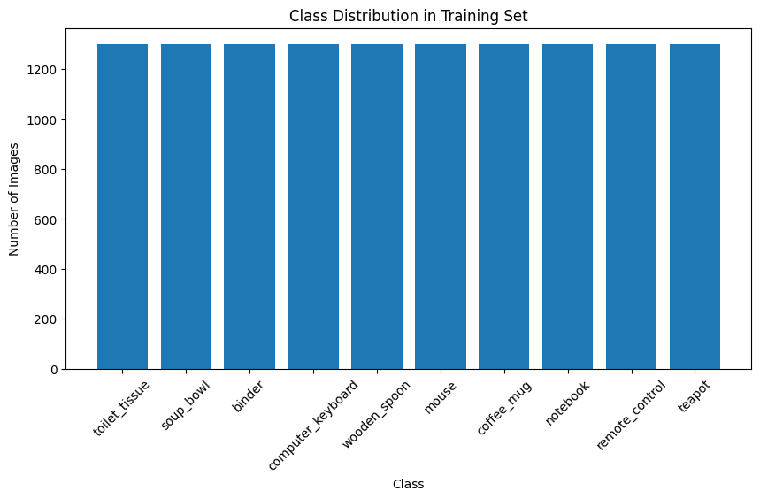
Class Distribution Analysis
Notes:
To ensure training quality, we verified whether each class has a balanced number of images. This helps detect dataset imbalance. If one class has far fewer images, the model may learn biased features. For now, most classes appear fairly balanced.

Slide 6

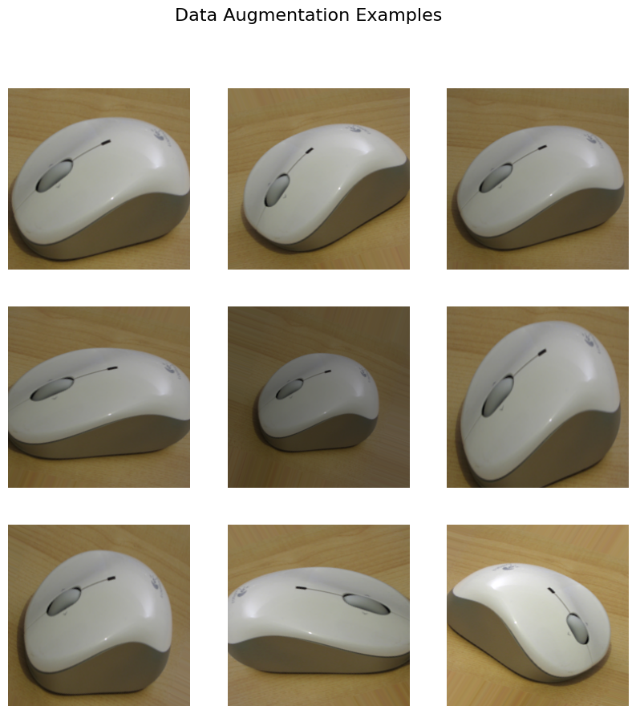
Data Augmentation
Explored Augmentation Techniques
Rotation
Horizontal flip
Zoom
Brightness changes
Notes:
Augmentation artificially increases dataset size and prevents overfitting. We previewed augmented images to understand how the model will see transformed data. This is crucial for improving accuracy in small datasets.

Slide 7
Loading the Dataset
ImageDataGenerator + DirectoryFlow
Auto-labels images based on folder names
Handles preprocessing
Supports augmentation
Loads batch by batch (memory-efficient)
Notes:
We used ImageDataGenerator to load images from folders. This avoids memory issues and enables real-time preprocessing and augmentations. It’s the standard approach for image classification tasks in TensorFlow/Keras.

Slide 8
Selected Models for Comparison:
1. MobileNetV2:
Lightweight architecture optimized for speed and efficiency on limited hardware.
2. ResNet50:
Deep residual network designed for high-capacity learning and complex feature extraction.
Notes:
We researched CNN architectures and selected MobileNetV2 as our first model.
MobileNetV2 Looks at one thing at a time
Instead of mixing all image colors at once, it looks at each color separately, then mixes them
This saves a lot of work Its depthwise separable convolutions reduce computation but maintain strong accuracy. It’s ideal when training resources are limited.

Slide 9
Model Selection - MobileNetV2
Primary Architecture: MobileNetV2
Key Characteristics:
Lightweight & Fast: Optimized for efficiency.
Pre-trained: Initialized with ImageNet weights (Transfer Learning).
Reasons for Selection:
High Accuracy: Proven performance on small datasets.
Resource Friendly: Works well on standard CPU/GPU (e.g., Colab, MacBook M4).
Notes:
We researched CNN architectures and selected MobileNetV2 as our first model.
MobileNetV2 Looks at one thing at a time
Instead of mixing all image colors at once, it looks at each color separately, then mixes them
This saves a lot of work Its depthwise separable convolutions reduce computation but maintain strong accuracy. It’s ideal when training resources are limited.

Slide 10
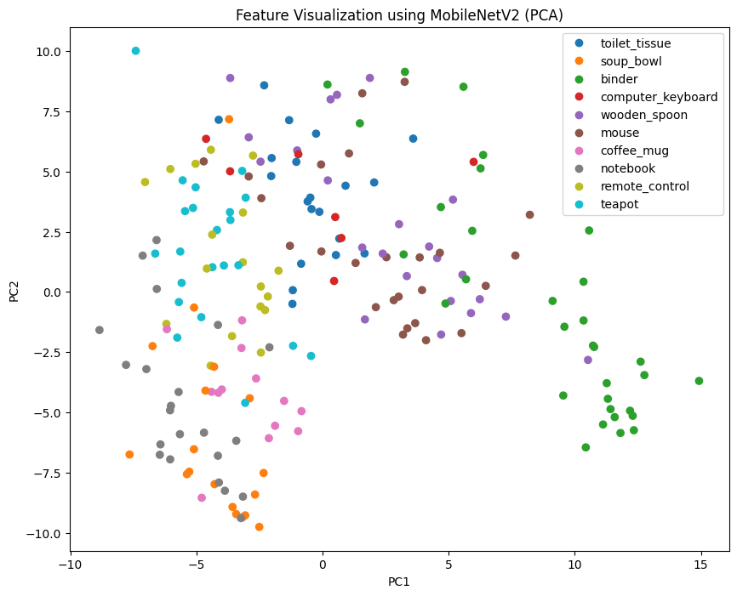
Feature Visualization (PCA)
PCA on MobileNetV2 Feature Embeddings
What is PCA?
Principal Component Analysis
Reduces high-dimensional data to 2D
Helps visualize how classes cluster
Notes:
After extracting features from MobileNetV2, we performed PCA to project them into 2D. This lets us visually inspect how well different classes separate in feature space. Good separation indicates stronger model learning.

Slide 11
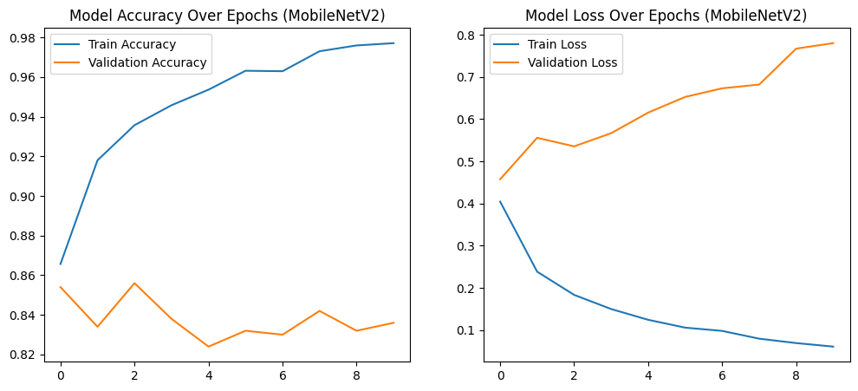
Model Training
Initial Model Training Results
Notes:
We trained the model for 10 epochs to observe learning trends. EPOCH: One complete cycle where the neural network sees the entire training dataset exactly once. The accuracy curve shows how the model improves with each epoch. The validation accuracy helps check generalization.

Slide 12
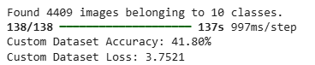
Evaluation on Custom Dataset ON MOBILENETV2 MODEL
Experiment:
Evaluation of previously trained MobileNetV2Input: "Hard"
Custom Dataset (Totally New)
Result:
Accuracy: 41.80%
Loss: 3.75
Observation
Significant drop in performance
Reason: Model untested on this specific data distribution
Notes:
We performed an evaluation on the Custom Dataset provided to us. We used our previously trained MobileNet model and tested it on this totally new data.
The result was an accuracy of 41.80%. Since this dataset was completely new to our training model, the accuracy dropped significantly compared to our training results. This proves the data was much harder and different from what the model had learned before."

Slide 13
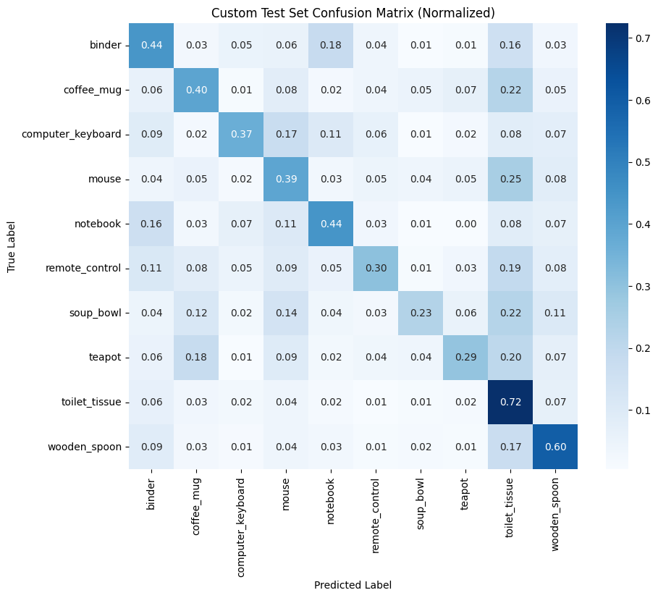
Detailed Metrics (Confusion Matrix)
Notes:
"This heatmap visualizes exactly where our model is failing. The Y-axis shows the True Labels, and the X-axis shows what the model Predicted."
"The Good: The diagonal line represents correct predictions. We see strong performance for Toilet Tissue (0.72) and Wooden Spoon (0.60)."
"The Bad (Shape Confusion): Look at the Binder row. It is frequently confused with Notebooks (0.18) and vice versa (0.16). This makes sense because both are flat, rectangular objects."
"The Ugly (The Bias): Notice the Toilet Tissue column. Many other classes like Mouse (0.25) and Coffee Mug (0.22) are incorrectly predicted as Toilet Tissue. This confirms the 'Context Bias' we suspected earlier—when the model is unsure, it guesses 'Toilet Tissue'."

Slide 14
Detailed Metrics (Confusion Matrix)
Analysis: Breakdown of accuracy per class The "Easy" Classes: Examples: Computer Keyboard, Teapot Reason: Unique shapes, distinct handles/keys The "Confused" Classes: Conflict: mouse == toilet_tissue Reason: Strong visual similarity (Rectangular/Flat)
Notes:
We looked deeper using a Confusion Matrix to see exactly where the model failed.
We found that the model is very good at identifying objects like the Computer Keyboard or the Teapot.
However, it struggles with objects that look very similar. For example, it frequently confuses mouse with toilet issue.

Slide 15
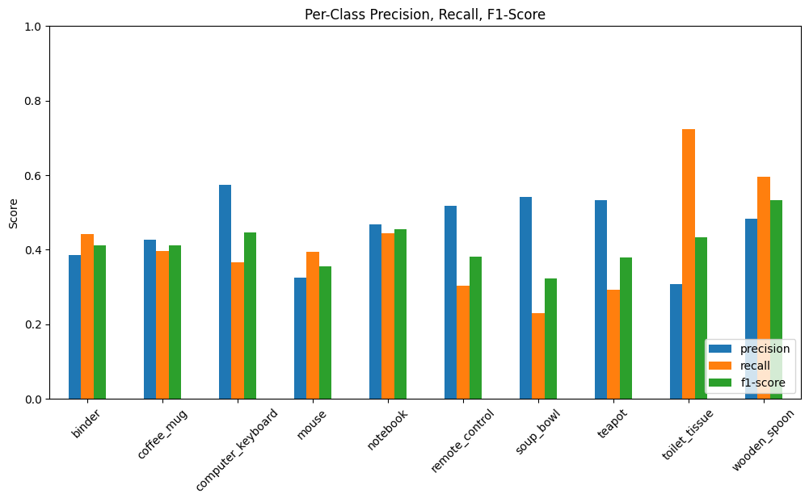
Detailed Metrics (F1 Score)
Notes:
"Here we break down the performance mathematically using Precision (Blue), Recall (Orange), and F1-Score (Green)."
"The Anomaly: Look at the Toilet Tissue bars on the far right.
The Recall (Orange) is very high (~70%), meaning it finds almost all the real toilet tissue.
But the Precision (Blue) is very low (~30%).
Interpretation: The model is 'spamming' the Toilet Tissue prediction. Because it predicts it so often, it catches the real ones (High Recall) but also generates massive false positives (Low Precision)."
"General Performance: Most other classes show a balanced but mediocre F1-score (Green bars around 0.40), consistent with our overall 41% accuracy on this difficult dataset."

Slide 16
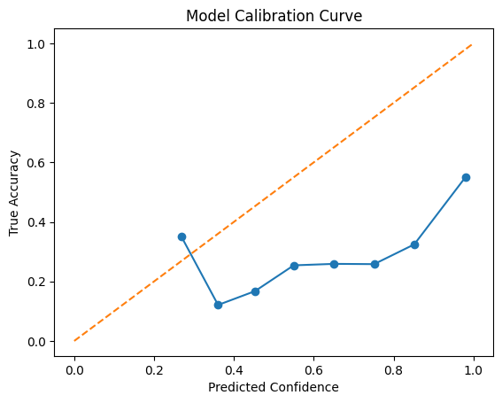
Model Calibration
Definition: Reliability check (Confidence vs. Actual Accuracy)
The Graph:
Orange Line: Perfect Calibration (Ideal)
Blue Line: Our Model's Performance
Observation: Blue line is consistently below the orange line Diagnosis: Severe Overconfidence
Meaning:
At 100% confidence, the model is only ~55% accurate Risk: High trust in false predictions
Notes:
We asked: 'Does the model know when it is confused?'
To answer this, we plotted the Calibration Curve. The Orange line represents a perfect model—if it says it is 80% sure, it should be correct 80% of the time.
But looking at the Blue line, we see it falls far below the ideal. This indicates our model is Overconfident. For example, look at the far right: when the model claims to be 100% confident, it is actually correct only about 55% of the time. This is a critical risk, as the model claims certainty even when it is wrong

Slide 17
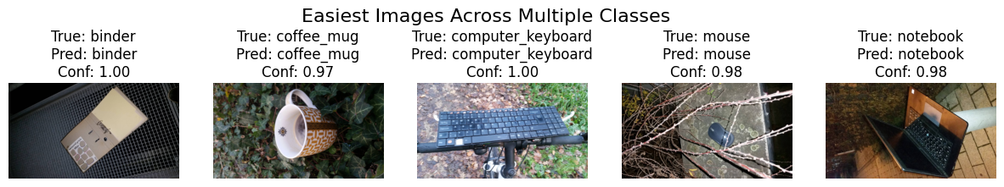
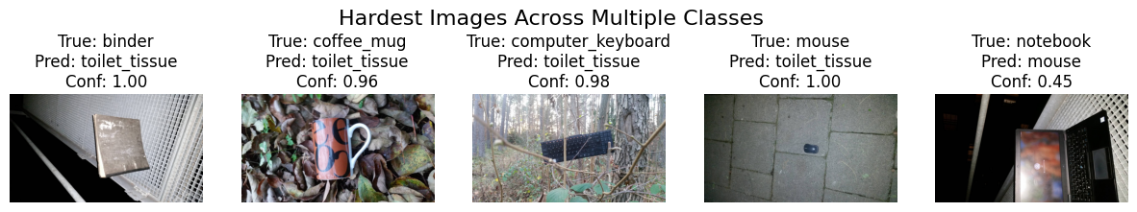
Analysis of Extremes

Slide 18
Analysis of Extremes
Analysis: Qualitative check of model predictions
Easiest Cases :
Status: Correct Prediction + High Confidence (>97%)
Features: Distinct shapes (e.g., Keyboard grids, Mug handles)
Hardest Cases :
Status: Wrong Prediction + Extreme Overconfidence (1.00)
The "Toilet Tissue" Bias:
Model incorrectly labels Binder, Mug, & Mouse as "toilet_tissue“
Confidence: 96% - 100% (Severe Error)
Notes:
We compared the best and worst predictions.In the top row, the 'Easiest' images are correctly identified with high confidence. The model easily recognizes distinct shapes like the grid of a keyboard or the handle of a mug.But the bottom row reveals a major failure. Look at the predictions: the model thinks the Binder, the Mug, and the Mouse are all 'Toilet Tissue', and it is 100% sure about it! This shows that on this new dataset, the model is completely broken for certain objects and just guesses 'Toilet Tissue' whenever it is confused."

Slide 19
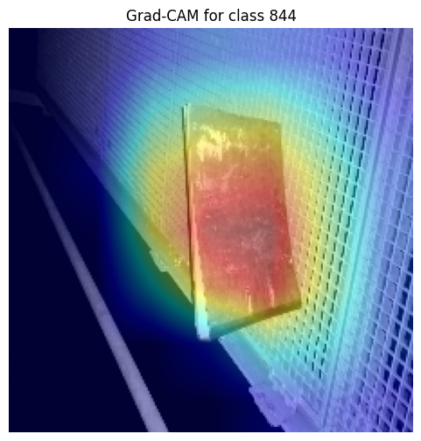
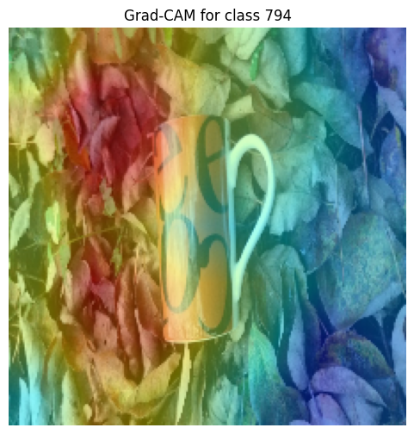
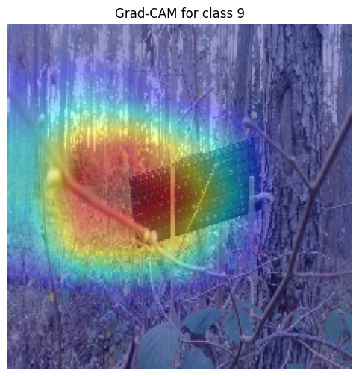
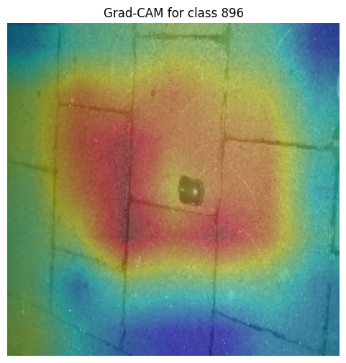
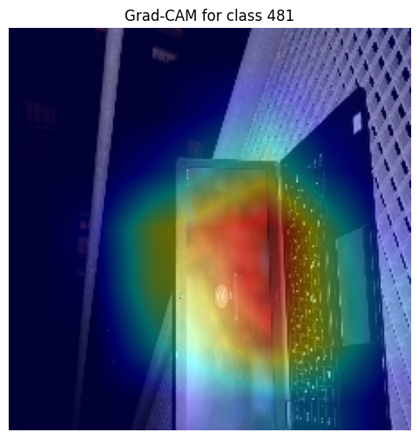
Explainability (Grad-CAM)

Slide 20
Explainability (Grad-CAM)
Motivation: Investigating the low accuracy (41.8%)
Method: Grad-CAM (Visualizing Model Focus)
Observations:
Success: On simple backgrounds, model focuses on the object (e.g., Mug).
Failure: On complex backgrounds (e.g., Binder on Grille), model gets confused.
Insight:
Model is distracted by background textures (Grilles, Woods).
This "Noise" leads to incorrect predictions.
Notes:
We were shocked by the low 41% accuracy, so we used Grad-CAM to investigate why the model was failing. We wanted to see exactly where the model was looking.The heatmaps gave us the answer. In successful cases, the model looks at the object. But in failure cases—like the keyboard in the woods or the binder on the grille—the heatmap shows the model is distracted by the background textures. It isn't just seeing the object; it's getting confused by the environment."

Slide 21
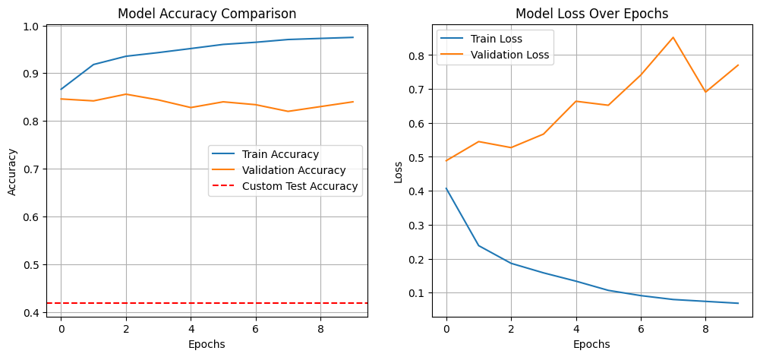
Generalization Analysis (Test vs. Custom)
Visualizing the "Reality Gap"
Performance Metrics:
Validation Accuracy (Orange Line): 84% (Standard Data)
Custom Test Accuracy (Red Line): 41.8% (Real World)
The Drop: 42% decrease in performance.
Conclusion: High validation scores do not guarantee real-world success.
Notes:
"This graph summarizes our main finding. The Orange line shows our validation accuracy during training, which was high—around 84%.
But the Red dashed line at the bottom is our Custom Test accuracy—only 41.8%. This massive gap visually proves that our model overfitted to the 'easy' training data and failed to generalize to the 'hard' real-world data provided by the professor."

Slide 22
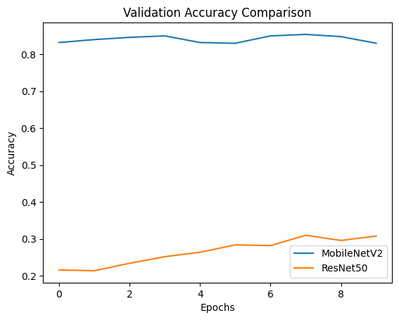
Comparative Experiment (ResNet vs. MobileNet)

Slide 23
Comparative Experiment (ResNet vs. MobileNet)
Hypothesis: Can a larger model (ResNet50) fix the accuracy drop?
The Result (Validation Accuracy):
MobileNetV2 (Blue): Stable, High Accuracy (~84%)
ResNet50 (Orange): Poor Performance (~30%)
Analysis:
ResNet50 is too complex for this small dataset.
Resulted in failed convergence / overfitting.
Decision: Discarded ResNet50; continued with MobileNetV2.
Notes:
We thought a bigger, more powerful model like ResNet50 might solve our accuracy problem. We were wrong.As you can see in this graph, the Orange line (ResNet50) performed terribly, stuck around 30% accuracy. The Blue line (MobileNet) was much better. This taught us that for a small dataset like ours, a complex model like ResNet just adds confusion. Bigger is not always better."

Slide 24
Conclusion & Key Learnings
Efficiency Wins:
MobileNetV2 (Lightweight) outperformed ResNet50 (Complex).
Finding: Complexity without sufficient data leads to failure (ResNet ~30% acc).
The "Generalization Gap":
Validation Accuracy (~84%) ≠Real World Performance (41.8%). ³
Lesson: High benchmark scores can hide real-world fragility. ⁴
The Value of Explainability (XAI):
Grad-CAM revealed the root cause: Context Bias (Backgrounds). Impact: transformed a "Black Box" failure into an actionable insight.
Notes:
"To wrap up, we learned three major lessons from this project.First, efficiency wins. The lightweight MobileNetV2 model significantly outperformed the complex ResNet50, which failed to learn effectively on our small dataset. This proves that added complexity is not a silver bullet.Second, we exposed a critical Generalization Gap. Our 84% validation score gave us a false sense of security, which was shattered by the 41.8% real-world accuracy. This teaches us that you must always test on 'messy' unseen data.Finally, we proved the value of Explainable AI. Without Grad-CAM, the low accuracy would have been a mystery. With it, we diagnosed the exact problem—background bias—proving that transparency is just as important as accuracy."

